Slide 1
Greg Mays, Director of Tennessee Office of Homeland Security, February 2023
Notes:
Thank you
My background
TN Nexus

Slide 2
TN Homeland Security’s Mission and Priorities
Investigations of Threats to Life/TN Homeland
Information and Intelligence Sharing
Critical Infrastructure Protection
Cyber Security
Election Security, Local Government, Private Sector
Preparedness
Special Events, Training, School Safety, Physical Security Assessments
School Security

Slide 3
Homeland Security & School Security
Since 2015, OHS has provided training to schools upon request. Active Shooter, threat/suspicious activity reporting, and bomb threat awareness.
Since 2016, OHS has reviewed K-12 public school emergency operations plans as part of the State’s School Security working group (multi-discipline group lead by DOE). OHS provides recommendations/ best practices for improvements to the EOPs.
In 2018, Tennessee Governor Bill Haslam convened a school security working group.
Out of that Working Group came the SafeTN App and School Assessments
Tennessee Code Annotated, Section 49-6-4302, requires school security assessments.
Notes:
History:
Since 2015, OHS has provided training to schools upon request. Active Shooter, threat/suspicious activity reporting, and bomb threat awareness.
Since 2016, OHS has reviewed K-12 public school emergency operations plans as part of the State’s School Security working group (multi-discipline group lead by DOE). OHS provides recommendations/ best practices for improvements to the EOPs.
In 2018, OHS developed physical security standards for K-12 public schools based on evaluated risk/threat levels.
In 2018, OHS created ‘SafeTN’ – our suspicious activity reporting app. This app was originally designed for school threat reporting. In 2022, OHS updated the app to include a mechanism to report threats/suspicious activity within communities, as well as within schools.
Starting in 2019, OHS Agents review, and conduct walk thrus of select schools, verify the findings in the school’s self-assessment, and provide security recommendations and consultation (facility construction and security devices such as locks, cameras, fences, etc. ).
In 2020, the K-12 security standards were updated in cooperation with DOE.

Slide 4
Homeland Security & School Security
Notes:
SafeTN is a secure, open door communications App that allows anonymous reporting of suspicious activity and access useful resources to help keep your school and community safe.
A few months ago, a high school student in West Tennessee noticed something suspicious. He reported his suspicion in the SafeTN app, and the situation was routed to one of our Homeland Security agents. The agent pursued the tip, and we strongly believe this intervention prevented a real threat from becoming a real tragedy.
We started developing SafeTN in 2018 (it was finished and rolled out in early 2019) after then Gov Haslam established a school security working group to develop recommendations for improving school security after the Parkland shooting.
Depending on the nature of the information, tips may go directly to school’s administrator (for non-criminal or administrative issues), or local law enforcement, or HS Agents may initiate an investigation if warranted. 15,000+ downloads to date. 500 + submissions to date

Slide 5
Homeland Security & School Security
In 2022, Tennessee Governor Bill Lee issued Executive Order 97, which directed accountability measures for school safety and an evaluation of training for Tennessee law enforcement. The order also established additional resources to support parents, teachers, and law enforcement in improving school security practices.
Notes:
Following the tragedy in Uvalde, TX, Governor Lee issued EO #97

Slide 6
OHS Role in School Security Going Forward
Legislation has passed that will make district level threat assessment teams mandatory (they are currently encouraged, but not required). Homeland Security will work with Sheriffs and Chiefs, mental health, DOE, and others on these multidisciplinary teams within each school district - to identify problem youths early and intervene and then regularly monitor
The Governor’s budget proposal includes an expansion of OHS to have an agent in every county to assist with school security, critical infrastructure security, cyber security, major event security, and counter-terrorism work.
Homeland Security personnel are trained in behavior-based threat investigations and can assist local law enforcement with these investigations.
Homeland Security is NOT taking over school security.
Notes:
Through the proposed legislative and OHS expansion, Homeland Security is gaining NO additional jurisdiction or authorities – only expanded capabilities to do what we are doing now, just more of it in more places.
Homeland Security created and manages the SafeTN app, where kids can report threats or concerns, or seek help. All SafeTN submissions go to Homeland Security and are either worked or referred immediately to local authorities.
Homeland Security can assist schools and local law enforcement

Slide 7
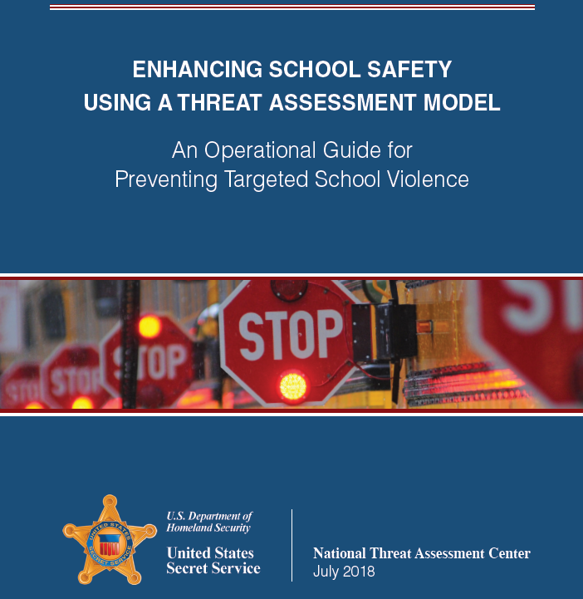
NTAC’s Enhancing School Safety Guide
Step 1: Establish a multidisciplinary threat assessment team
Notes:
Per the steps in the U.S. Department of Homeland Security and the United States Secret Service’s Enhancing School Safety Using a Threat Assessment Model, an Operational Guide for Preventing Targeted School Violence, we are involved in step 1. Part of our assignment is to assist with creating the multidisciplinary threat assessment, which involves directing, managing, and documenting the threat assessment process. We must create an environment where kids feel comfortable reporting.

Slide 8
SRO Grant Program
$140M SRO Grant
Amount not to exceed 75,000 per SRO with one SRO per school allowable.
Money to go directly to the local LE agencies responsible for providing SROs to the schools
MOU between the LE agency and the schools will be required
MOU outline roles and responsibilities of the SRO and the school.
Recurring funds
Agencies already providing/paying for SROs will still be eligible for the funding.
Application on Homeland Security website – approx. 1st week of June
Additional Grants of $7M and $40M for School security thru TDOE
$7M grant is for private schools
$40M grant is for K-12 public schools
Notes:
Through the proposed legislative and OHS expansion, Homeland Security is gaining NO additional jurisdiction or authorities – only expanded capabilities to do what we are doing now, just more of it in more places.
Homeland Security created and manages the SafeTN app, where kids can report threats or concerns, or seek help. All SafeTN submissions go to Homeland Security and are either worked or referred immediately to local authorities.
Homeland Security can assist schools and local law enforcement

Slide 9
TN Homeland Security’s Mission and Priorities
Questions?
Notes:
Led by the Director who serves as the state’s Deputy Homeland Security Advisor. The Office of Homeland Security Special Agents partner with federal, state and local law enforcement and public safety agencies to conduct homeland security related and Threat to Life investigations; as well as collect, analyze, and disseminate intelligence through the Homeland Security Intelligence Analysts at the Tennessee Fusion Center.

